Slide 1
Operating System (CS251) EDITED BY DR. Ibrahim El desoky

Slide 2
Lecture 1 Chapter 1: Introduction

Slide 3
Chapter 1: Introduction
What Operating Systems Do
Computer-System Organization
Computer-System Architecture
Operating-System Structure
Operating-System Operations
Process Management
Memory Management
Storage Management
Protection and Security
Kernel Data Structures
Computing Environments
Open-Source Operating Systems

Slide 4
Objectives
To describe the basic organization of computer systems
To provide a grand tour of the major components of operating systems
To give an overview of the many types of computing environments
To explore several open-source operating systems

Slide 5
What is an Operating System?
A program that acts as an intermediary between a user of a computer and the computer hardware
Operating system goals:
Execute user programs and make solving user problems easier
Make the computer system convenient to use
Use the computer hardware in an efficient manner

Slide 6
Computer System Structure
Computer system can be divided into four components:
Hardware – provides basic computing resources
CPU, memory, I/O devices
Operating system
Controls and coordinates use of hardware among various applications and users
Application programs – define the ways in which the system resources are used to solve the computing problems of the users
Word processors, compilers, web browsers, database systems, video games
Users
People, machines, other computers

Slide 7
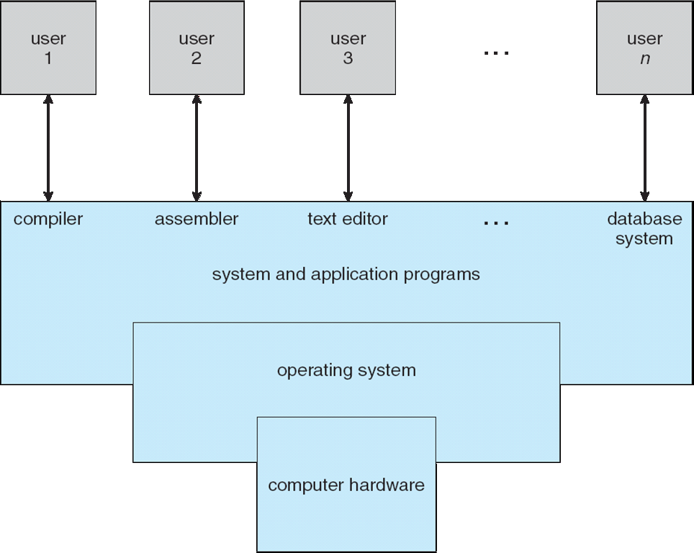
Four Components of a Computer System

Slide 8
What Operating Systems Do
Depends on the point of view
Users want convenience, ease of use and good performance
Don’t care about resource utilization
But shared computer such as mainframe or minicomputer must keep all users happy- The operating system in such cases is designed to maximize resource utilization by Dividing CPU time, memory, and I/O to all users
Users of dedicate systems such as workstations have dedicated resources but frequently use shared resources from servers
Handheld computers are resource poor, optimized for usability and battery life
Some computers have little or no user interface, such as embedded computers in devices and automobiles

Slide 9
System View
OS is a resource allocator
A computer system has many resources that may be required to solve a problem: CPU time, memory space, file-storage space, I/O devices, and so on.
The operating system acts as the manager of these resources.
Decides between conflicting requests for efficient and fair resource use
OS is a control program
Controls execution of user programs to prevent errors and improper use of the computer

Slide 10
Operating System Definition
No universally accepted definition
The fundamental goal of computer systems is to execute user programs and to make solving user problems easier.
Computer hardware is constructed toward this goal. Since bare hardware alone is not particularly easy to use, application programs are developed.
These programs require certain common operations, such as those controlling the I/O devices. The common functions of controlling and allocating resources are then brought together into one piece of software: the operating system
Operating systems exist because they offer a reasonable way to solve the problem of creating a usable computing system.

Slide 11
Operating System Definition (Cont.)
“Everything a vendor ships when you order an operating system” is a good approximation
But varies wildly
“The one program running at all times on the computer” is the kernel.
Everything else is either
a system program (ships with the operating system) , or
an application program.

Slide 12
Computer Startup
bootstrap program is loaded at power-up or reboot
Typically stored in ROM ( Read Only Memory)or EPROM (Erasable Programmable ROM), generally known as firmware
Initializes all aspects of system from CPU registers to device controllers to memory contents
Loads operating system kernel and starts execution

Slide 13
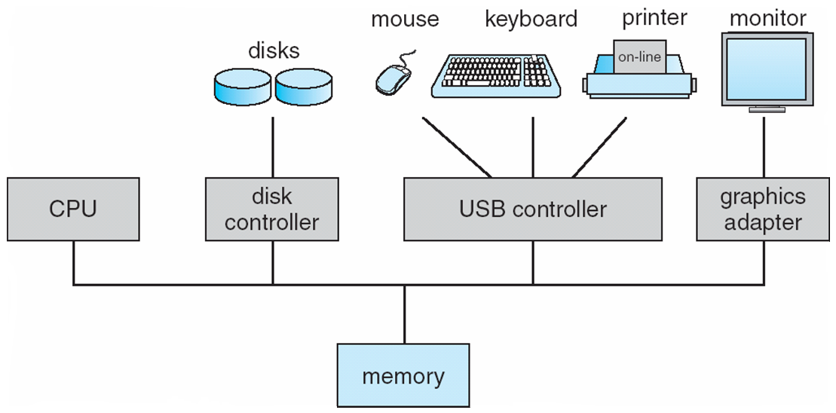
Computer System Organization
Computer-system operation
One or more CPUs, device controllers connect through common bus providing access to shared memory
Concurrent execution of CPUs and devices competing for memory cycles

Slide 14
Computer-System Operation
I/O devices and the CPU can execute concurrently
Each device controller is in charge of a particular device type
Each device controller has a local buffer storage and a set of special purpose registers.
Operating System (OS) have a Device Driver for each Device Controller
CPU moves data from/to main memory to/from local buffers
I/O is from the device to local buffer of controller
Device controller informs CPU that it has finished its operation by causing an interrupt

Slide 15
Computer-System Operation
To start I/O operation, the device driver loads the appropriate registers within the device controller
The device controller examines the contents of these registers
The controller starts the transfer of data from the device to its local buffer
Once the transfer of data is complete, the device controller informs the device driver via an Interrupt that it has finished its operation
The device driver then returns control to OS
This form of interrupt-driven I/O is fine for moving small amounts of data but produce high overhead when used for bulk data movement.
To solve this problem Direct Memory Access (DMA) is used as will be shown later.

Slide 16
Common Functions of Interrupts
Interrupt transfers control to the interrupt service routine generally, through the interrupt vector, which contains the addresses of all the service routines
Interrupt architecture must save the address of the interrupted instruction
A trap or exception is a software-generated interrupt caused either by an error or a user request
An operating system is interrupt driven

Slide 17
Interrupt Handling
The operating system (OS) preserves the state of the CPU by storing registers and the program counter
Separate segments of code determine what action should be taken for each type of interrupt

Slide 18
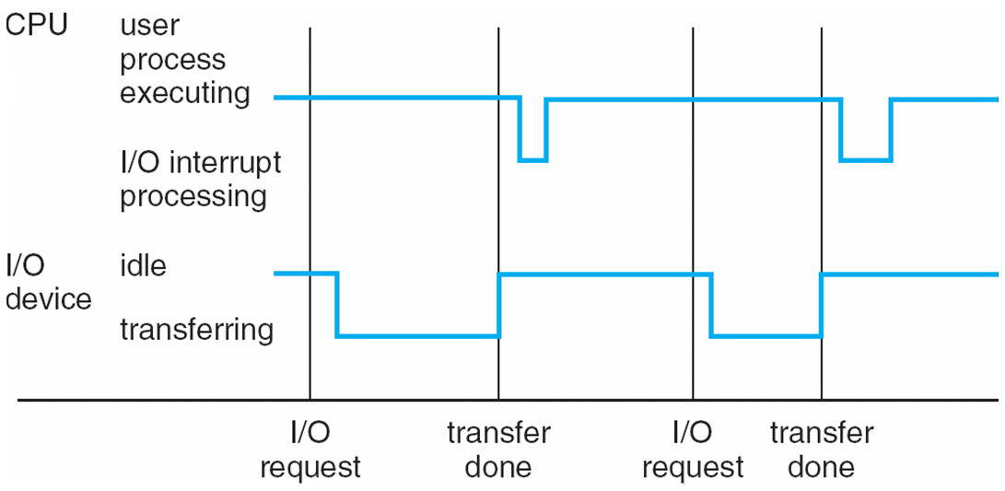
Interrupt Timeline

Slide 19
Storage Definitions and Notation Review
The basic unit of computer storage is the bit. A bit can contain one of two values, 0 and 1. All other storage in a computer is based on collections of bits. Given enough bits, it is amazing how many things a computer can represent: numbers, letters, images, movies, sounds, documents, and programs, to name a few. A byte is 8 bits, and on most computers it is the smallest convenient chunk of storage. For example, most computers don’t have an instruction to move a bit but do have one to move a byte. A less common term is word, which is a given computer architecture’s native unit of data. A word is made up of one or more bytes. For example, a computer that has 64-bit registers and 64-bit memory addressing typically has 64-bit (8-byte) words. A computer executes many operations in its native word size rather than a byte at a time.
Computer storage, along with most computer throughput, is generally measured and manipulated in bytes and collections of bytes.
A kilobyte, or KB, is 1,024 bytes
a megabyte, or MB, is 1,024² bytes
a gigabyte, or GB, is 1,024³ bytes
a terabyte, or TB, is 1,024⁴ bytes
a petabyte, or PB, is 1,024⁵ bytes
Computer manufacturers often round off these numbers and say that a megabyte is 1 million bytes and a gigabyte is 1 billion bytes. Networking measurements are an exception to this general rule; they are given in bits (because networks move data a bit at a time).

Slide 20
Storage Structure
Main memory – only large storage media that the CPU can access directly
Random access
Typically volatile
Secondary storage – extension of main memory that provides large nonvolatile storage capacity
Hard disks – rigid metal or glass platters covered with magnetic recording material
Disk surface is logically divided into tracks, which are subdivided into sectors
The disk controller determines the logical interaction between the device and the computer
Solid-state disks – faster than hard disks, nonvolatile
Various technologies
Becoming more popular

Slide 21
Storage Hierarchy
Storage systems organized in hierarchy
Speed
Cost
Volatility
Caching – copying information into faster storage system; main memory can be viewed as a cache for secondary storage
Device Driver for each device controller to manage I/O
Provides uniform interface between controller and kernel

Slide 22
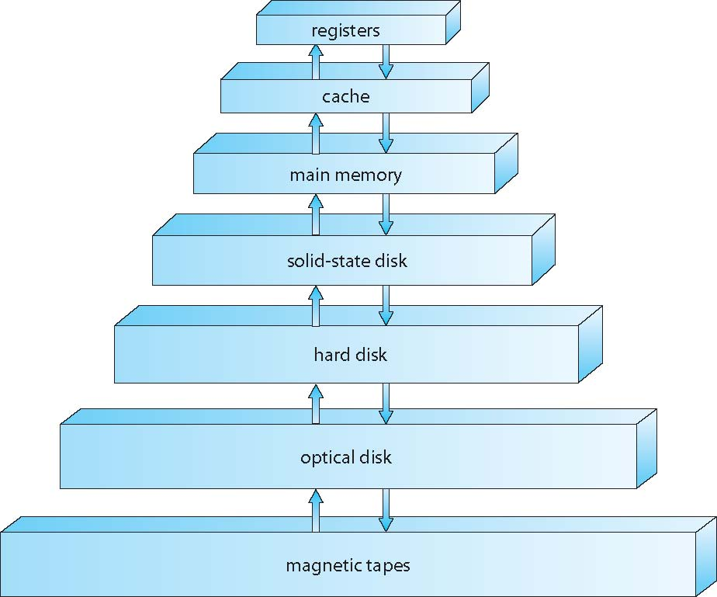
Storage-Device Hierarchy

Slide 23
Caching
Caches installed to improve performance.
Important principle, performed at many levels in a computer (in hardware, operating system, software)
Information in use copied from slower to faster storage temporarily
Faster storage (cache) checked first to determine if information is there
If it is, information used directly from the cache (fast)
If not, data copied to cache and used there
Cache smaller than storage being cached
Cache management important design problem
Cache size and replacement policy

Slide 24
Direct Memory Access Structure
Used for high-speed I/O devices able to transmit information at close to memory speeds
Device controller transfers blocks of data from buffer storage directly to main memory without CPU intervention
Only one interrupt is generated per block, rather than the one interrupt per byte

Slide 25
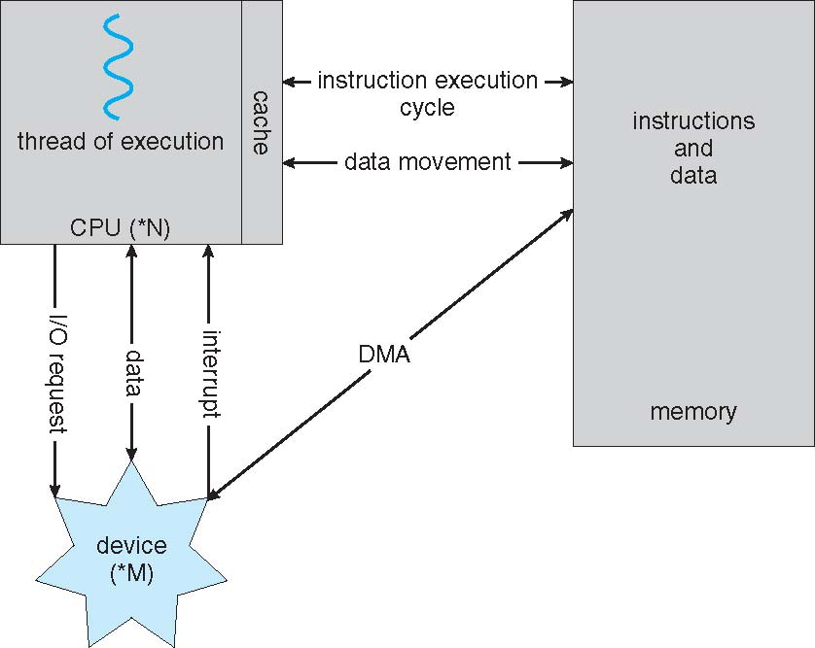
How a Modern Computer Works
A von Neumann architecture

